Slide 1
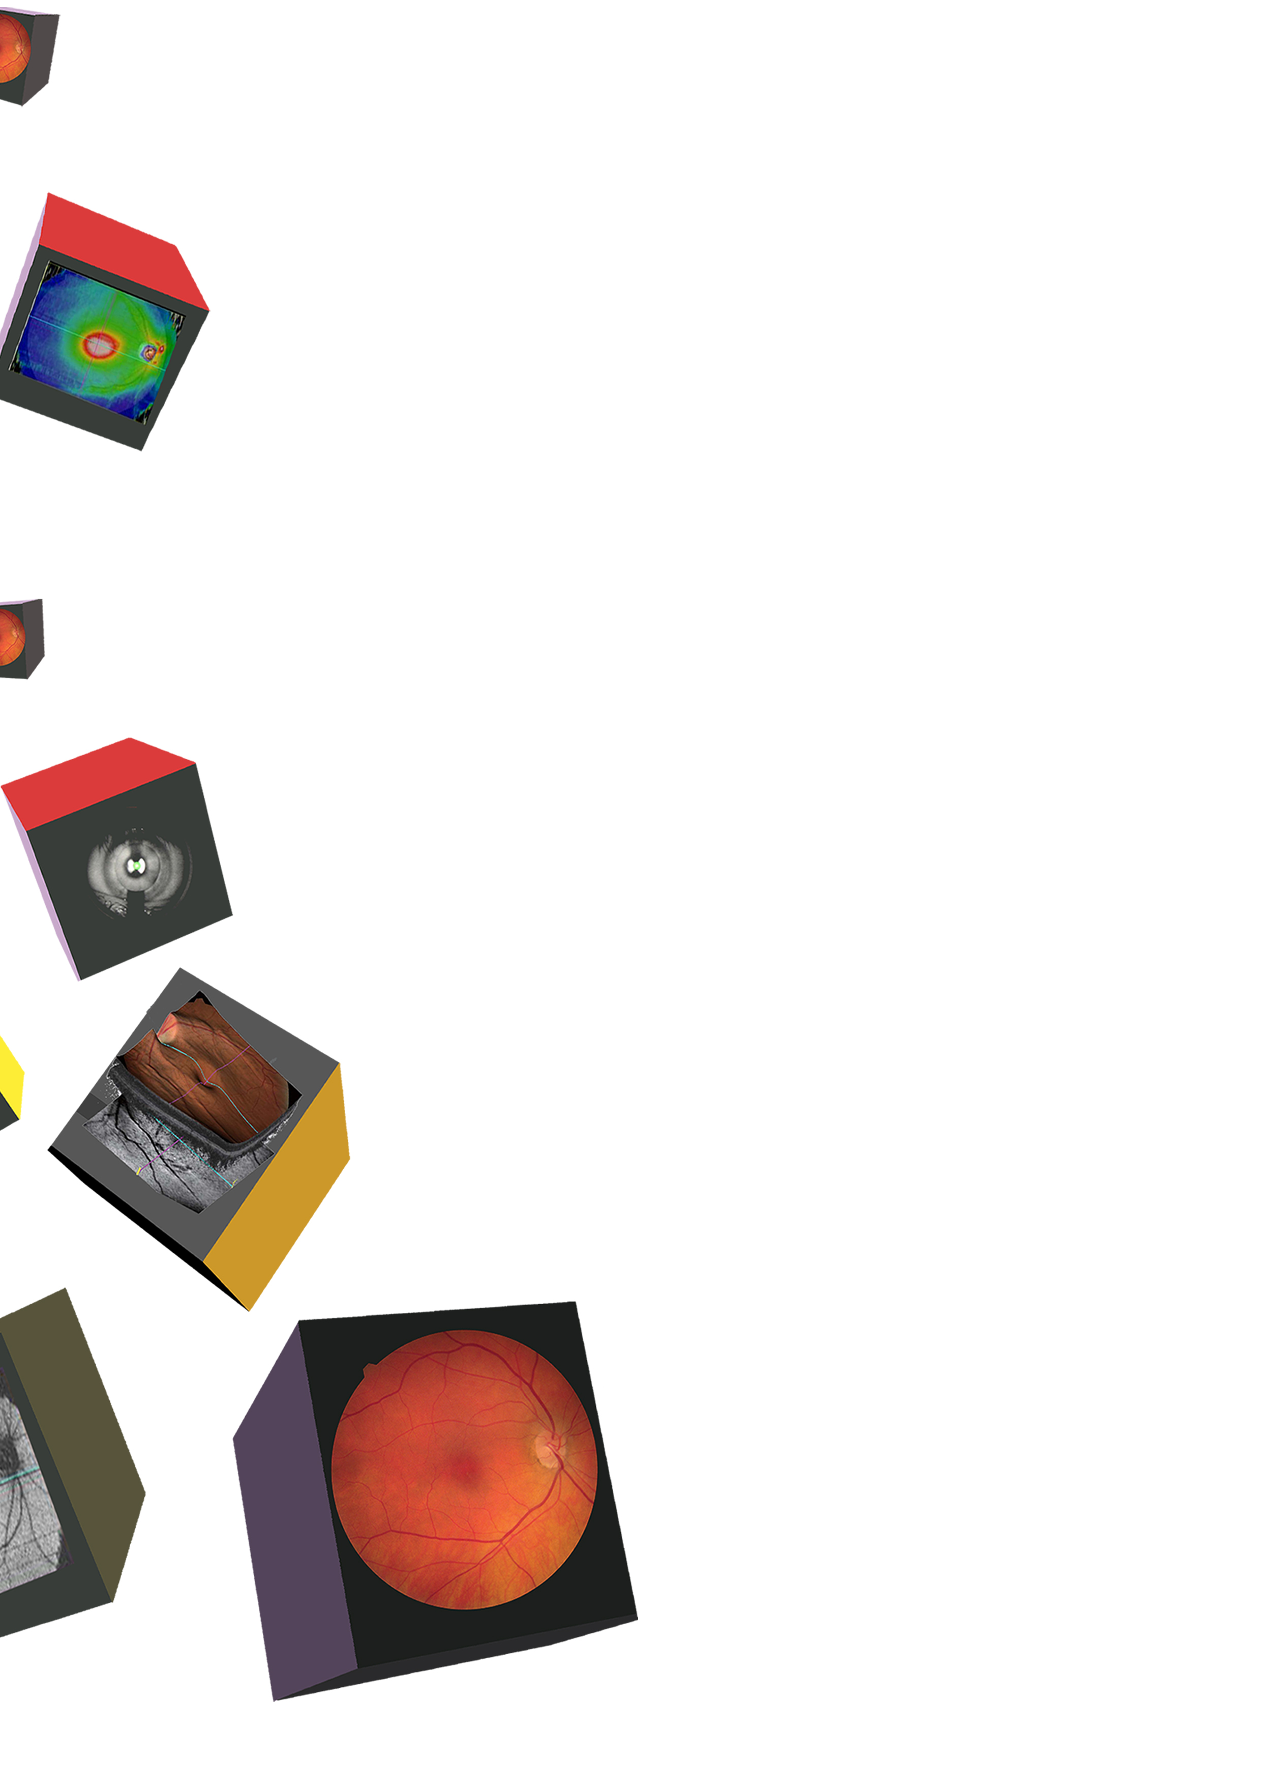
SEE MORE
than before

Slide 2
With the OCT Health Scan
It’s not just your vision we care about, it’s your health too. With an OCT eye scan, we can detect numerous diseases such as Diabetes, Glaucoma, Age Related Macular Degeneration and much more...

Slide 3


Slide 4
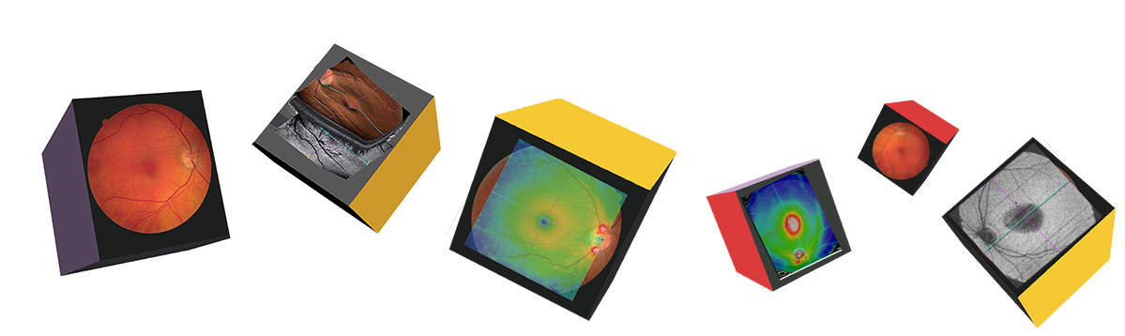
It’s not just your vision
we care about –
It’s your health too!

Slide 5
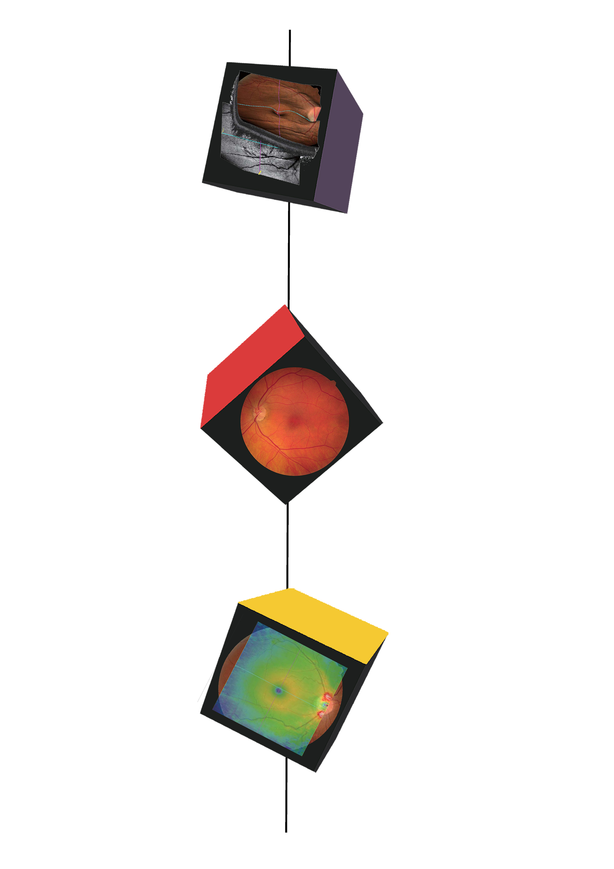
Look no further for your
OCT health scan
OCT (Optical Coherence Tomography) allows early detection and monitoring of numerous diseases such as:
Glaucoma
Diabetic Retinopathy
Age Related Macular Degeneration
Retinal Detachments
And much more…

Slide 6
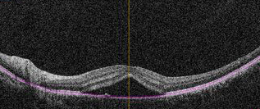
Your eyes are
quite extraordinary…
During an eye examination, the anterior of your eyes get looked at for any abnormalites, however with our new state-of-the-art OCT service, we can now scan the back of your eyes in incredible detail, not visible by other means.

Slide 7
It is crucial to look after your health,
aswell as your vision

Slide 8
Which is why you should say yes to the OCT health check…
Having an OCT health test as part of your usual eye examination will allow us to obtain the most detailed information about your overall eye health.
Early detection will lead to timely treatment and better outcomes for the health of your eye and your overall health.

Slide 9
OCT FAQ’s
Everything you need to know

Slide 10
Does it hurt?
No, nothing at all touches your eye
What happens during the scan?
You are simply required to sit in one position and look at a target through the device. The scan will end with a quick camera flash
Is OCT suitable for children?
Yes, it is important for children to undergo a quality routine eye examination
How long does it take?
It is a very quick process and will add on a few extra minutes to your eye examination

Slide 11
OCT Health Check
In 3 simple steps

Slide 12

You place your chin on the chinrest of the device
The device will take numerous scans of your eyes which will take just a few minutes (nothing touches your eye at all)
Your Optometrist will discuss your scans with you

Slide 13
Ask in store today
and book your OCT health check

